Slide 1
MySQL Index & Orchestrator
Hong wei

Slide 2
Agenda
MySQL Index
Orchestrator
ProxySQL

Slide 3
MySQL Index
B-Tree indexes
Hash indexes
Spatial (R-Tree) indexes
Full-text indexes
Other types of index

Slide 4
B-Tree index query types
Match the full value
Match a leftmost prefix
Match a column prefix
Match a range of values
Match one part exactly and match a range on another part
Index-only queries

Slide 5
B-Tree index limitations
Not useful for the lookup does not start from the leftmost side of the indexed columns
Can’t skip columns in the index
storage engine can’t optimize accesses with any columns to the right of the first range condition
eg. WHERE last_name=“Smith” AND first_name LIKE ‘J%’ AND dob=‘1976-12-23’ the index access will use only thefirst two columns in the index, because the LIKE is a range condition.

Slide 6
Hash indexes
A hash index is built on a hash table and is useful only for exact lookups that use every column in the index. For each row, the storage engine computes a hash code of the indexed columns, which is a small value that will probably differ from the hash codes computed for other rows with different key values. It stores the hash codes in the index and stores a pointer to each row in a hash table.
In MySQL, only the Memory storage engine supports explicit hash indexes. They are the default index type for Memory tables, though Memory tables can have B-Tree indexes, too.

Slide 7
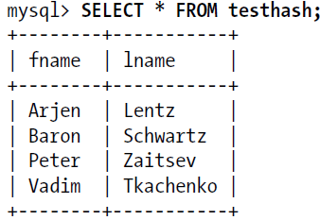
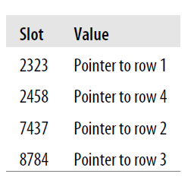
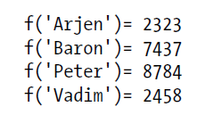
Hash index table
CREATE TABLE testhash (
fname VARCHAR(50) NOT NULL,
lname VARCHAR(50) NOT NULL,
KEY USING HASH(fname)
) ENGINE=MEMORY;
mysql> SELECT lname FROM testhash WHERE fname='Peter';
MySQL will calculate the hash of 'Peter' and use that to look up the pointer in the
index. Because f('Peter') = 8784, MySQL will look in the index for 8784 and find the
pointer to row 3. The final step is to compare the value in row 3 to 'Peter', to make
sure it’s the right row.

Slide 8
Building your own hash indexes
If your storage engine doesn’t support hash indexes, you can emulate them yourself in a manner similar to that InnoDB uses. This will give you access to some of the desirable properties of hash indexes, such as a very small index size for very long keys.
The idea is simple: create a pseudohash index on top of a standard B-Tree index. It will not be exactly the same thing as a real hash index, because it will still use the B-Tree index for lookups. However, it will use the keys’ hash values for lookups, instead of the keys themselves. All you need to do is specify the hash function manually in the query’s WHERE clause.

Slide 9
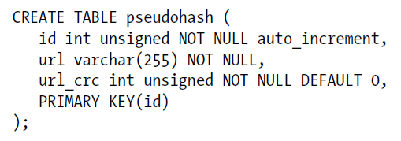
Building custom index case
This works well because the MySQL query optimizer notices there’s a small, highly
selective index on the url_crc column and does an index lookup for entries with that
value (1560514994, in this case). Even if several rows have the same url_crc value, it’s
very easy to find these rows with a fast integer comparison and then examine them to
find the one that matches the full URL exactly. The alternative is to index the full URL
as a string, which is much slower.

Slide 10
Benefits of Indexes
Indexes reduce the amount of data the server has to examine.
Indexes help the server avoid sorting and temporary tables.
Indexes turn random I/O into sequential I/O.
Note : An index isn’t always the right tool.

Slide 11
Indexing Strategies for High Performance
Isolating the Column
Prefix Indexes and Index Selectivity
Multicolumn Indexes
Choosing a Good Column Order
Clustered Indexes

Slide 12

Isolating the Column

Slide 13
Prefix Indexes and Index Selectivity
A prefix of the column is often selective enough to give good performance. If you’re indexing BLOB or TEXT columns, or very long VARCHAR columns, you must define prefix indexes, because MySQL disallows indexing their full length.
The trick is to choose a prefix that’s long enough to give good selectivity, but short enough to save space. The prefix should be long enough to make the index nearly as useful as it would be if you’d indexed the whole column. In other words, you’d like the prefix’s cardinality to be close to the full column’s cardinality.

Slide 14
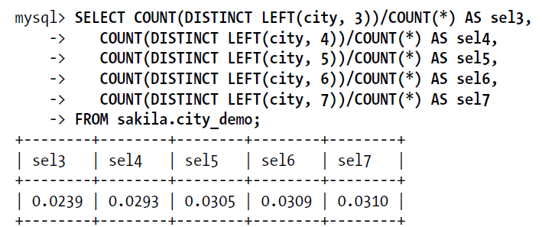
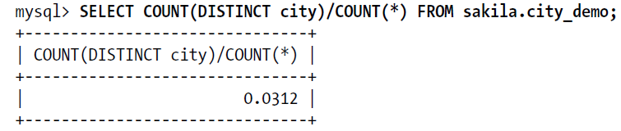
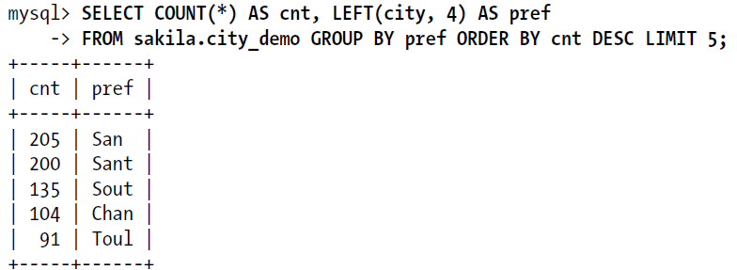
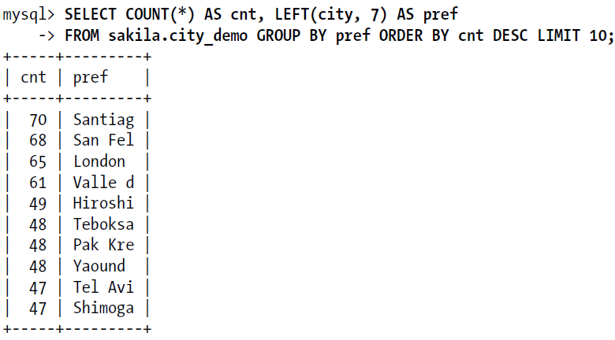
Index Selectivity case

Slide 15
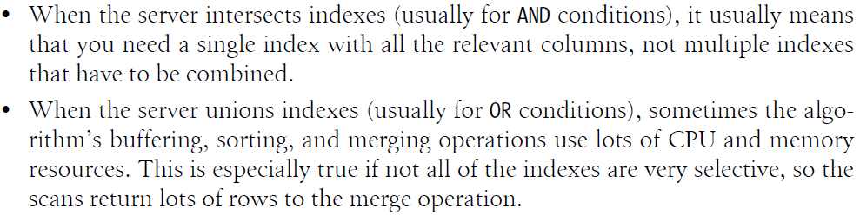
Multicolumn Indexes
CREATE TABLE t (
c1 INT,
c2 INT,
c3 INT,
KEY(c1),
KEY(c2),
KEY(c3)
);
“create indexes on columns that appear in the WHERE clause.” -wrong

Slide 16

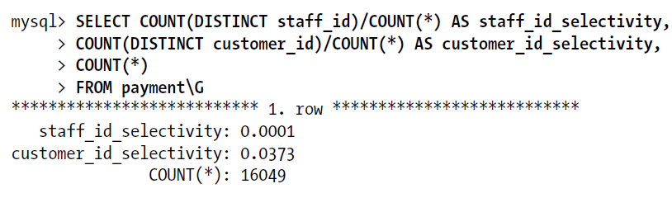
Choosing a Good Column Order
Placing the most selective columns first can be a good idea when there is no sorting or grouping to consider, and thus the purpose of the index is only to optimize WHERE lookups. In such cases, it might indeed work well to design the index so that it filters out rows as quickly as possible, so it’s more selective for queries that specify only a prefix of the index in the WHERE clause.

Slide 17
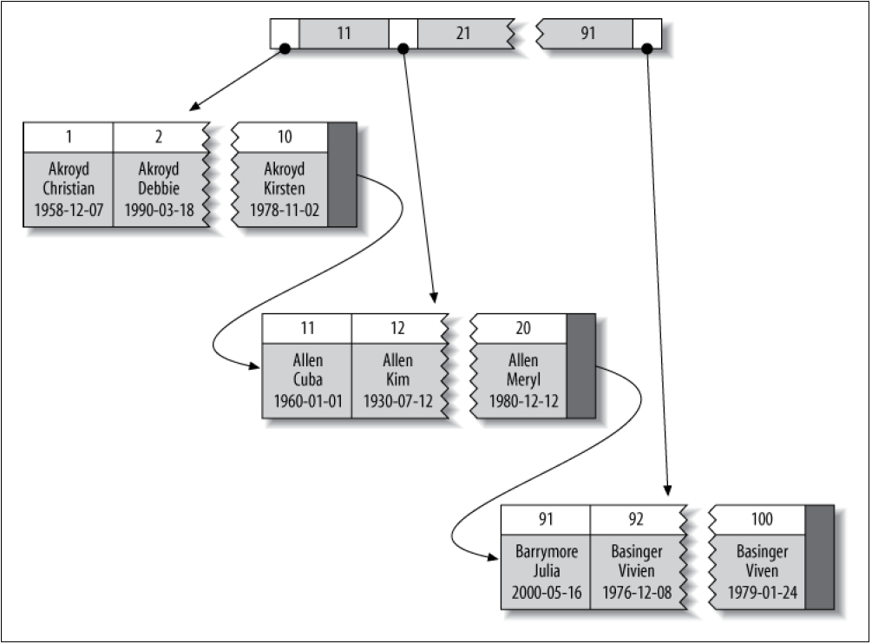
Clustered Indexes
Advantages
You can keep related data close together.
Data access is fast.
Queries that use covering indexes
can use the primary key values contained at the
leaf node.
disadvantages

Slide 18
Clustered Indexes-Advantages
You can keep related data close together. For example, when implementing a mailbox, you can cluster by user_id, so you can retrieve all of a single user’s messages by fetching only a few pages from disk. If you didn’t use clustering, each message might require its own disk I/O.
Data access is fast. A clustered index holds both the index and the data together in one B-Tree, so retrieving rows from a clustered index is normally faster than a comparable lookup in a nonclustered index.
Queries that use covering indexes can use the primary key values contained at the leaf node.

Slide 19
Clustered Indexes-Disadvantages
Clustering gives the largest improvement for I/O-bound workloads.
Insert speeds depend heavily on insertion order.
Updating the clustered index columns is expensive, because it forces InnoDB to move each updated row to a new location.
Tables built upon clustered indexes are subject to page splits when new rows are inserted, or when a row’s primary key is updated such that the row must be moved.
Clustered tables can be slower for full table scans, especially if rows are less densely packed or stored nonsequentially because of page splits.
Secondary (nonclustered) indexes can be larger than you might expect, because their leaf nodes contain the primary key columns of the referenced rows.
Secondary index accesses require two index lookups instead of one.

Slide 20
Comparison of InnoDB and MyISAM data layout
CREATE TABLE layout_test (
col1 int NOT NULL,
col2 int NOT NULL,
PRIMARY KEY(col1),
KEY(col2)
);

Slide 21
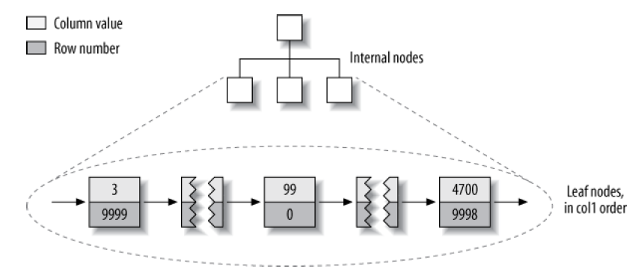
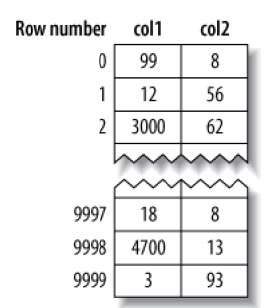
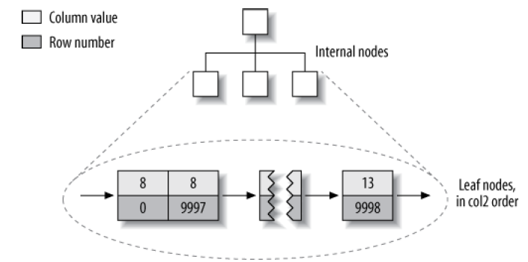
MyISAM’s data layout
MyISAM primary key layout
MyISAM col2 index layout

Slide 22
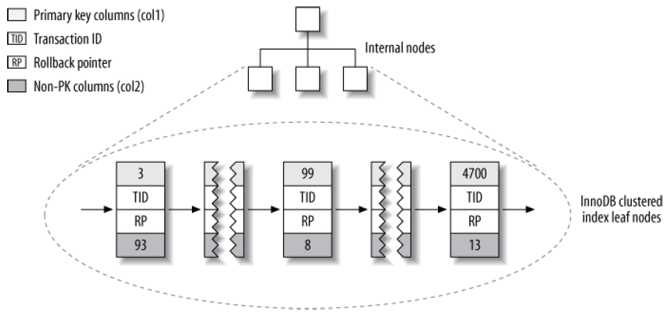
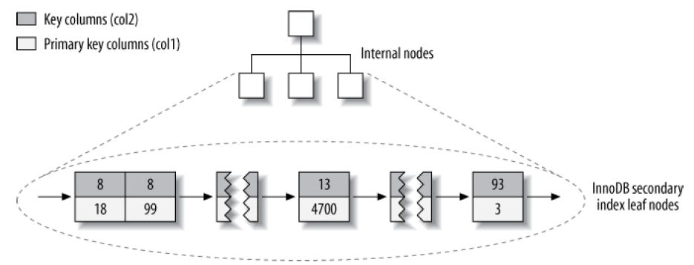
InnoDB primary key layout
InnoDB stores the same data very differently because of its clustered
organization.
InnoDB secondary index layout

Slide 23
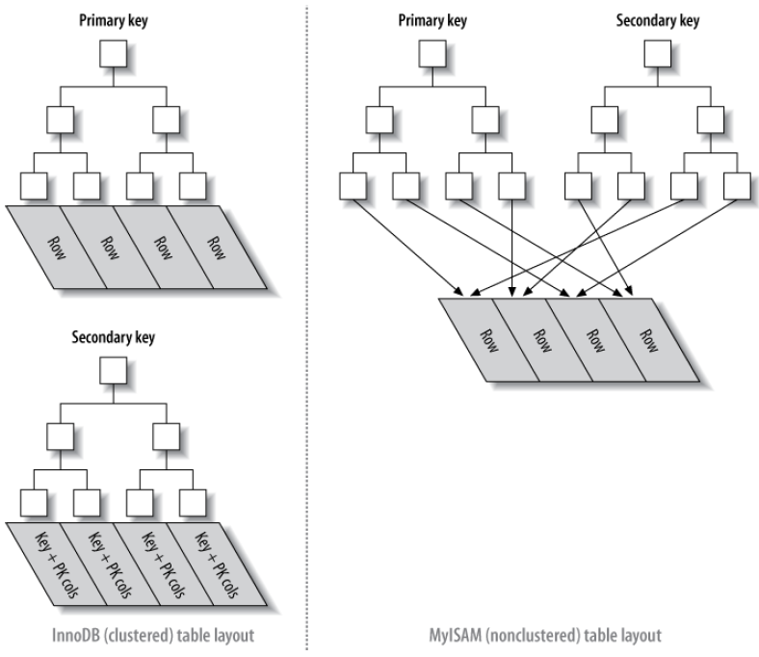
Inserting rows in primary key order with InnoDB

Slide 24
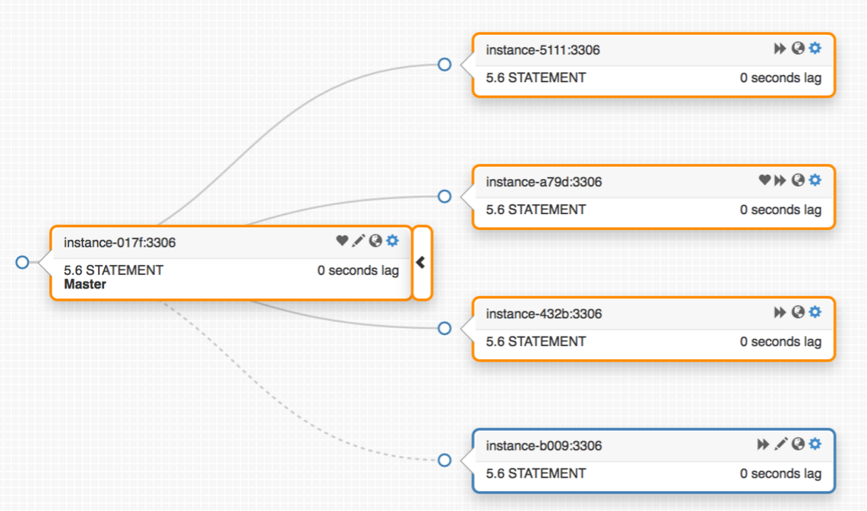
orchestrator
Discovery
Probe, read instances, build topology
graph, attributes, queries
Refactoring
Relocate replicas, manipulate, detach,
reorganize
Recovery
Analyze, detect crash scenarios, structure
warnings, failovers, promotions,
acknowledgements, flap control, downtime, hooks

Slide 25
Detection
orchestrator continuously probes all MySQL topology servers
At time of crash, orchestrator knows what the topology should look like, because it knows how it looked like a moment ago

Slide 26
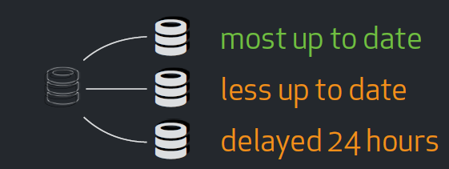
Promotion constraints
You wish to promote the most up to date replica,
otherwise you give up on any replica that is more advanced

Slide 27
Failover configuration
"ApplyMySQLPromotionAfterMasterFailover": true,
"MasterFailoverLostInstancesDowntimeMinutes": 10,
"FailMasterPromotionIfSQLThreadNotUpToDate": true,
"DetachLostReplicasAfterMasterFailover": true,
Special note for ApplyMySQLPromotionAfterMasterFailover:
RESET SLAVE ALL
SET GLOBAL read_only = 0

Slide 28
Commands
cd /usr/local/orchestrator && ./orchestrator --debug --stack http
the above looks for configuration in /etc/orchestrator.conf.json, conf/orchestrator.conf.json, orchestrator.conf.json in that order
orchestrator -c which-cluster -i some.instance.in.cluster
orchestrator -c which-replicas -i $master | shuf | head -1
orchestrator -c graceful-master-takeover -alias mycluster
orchestrator -c force-master-failover -alias mycluster

Slide 29
ProxySQL
ProxySQL is a high performance, high availability, protocol aware proxy for MySQL and forks (like Percona Server and MariaDB). All the while getting the unlimited freedom that comes with a GPL license.
Test:
mysql -u admin -padmin -h 127.0.0.1 -P6032 --prompt='Admin> ‘
Admin> SHOW DATABASES;
Admin> SELECT * FROM mysql_servers;
Admin> SELECT * from mysql_replication_hostgroups;
Admin> SELECT * from mysql_query_rules;
Admin> INSERT INTO mysql_query_rules (rule_id,active,match_digest,destination_hostgroup,apply)
VALUES
(1,1,'^SELECT COUNT\(\*\)',2,1);
Admin> SELECT hostgroup hg, sum_time, count_star, digest_text FROM stats_mysql_query_digest;

Slide 30
Orchestrator & proxySQL
"ApplyMySQLPromotionAfterMasterFailover": true,
"PreGracefulTakeoverProcesses": [
"/tmp/prefailover.sh"
],
"PostMasterFailoverProcesses": [
"/tmp/postfailover.sh"
]

Slide 31
/tmp/prefialover.sh
#!/bin/bash
# Variable exposed by Orchestrator
OldMaster=$ORC_FAILED_HOST
PROXYSQL_HOST=“mysql3"
# stop accepting connections to old master
(
echo 'UPDATE mysql_servers SET STATUS="OFFLINE_SOFT" WHERE hostname="'"$OldMaster"'";'
echo "LOAD MYSQL SERVERS TO RUNTIME;"
) | mysql -vvv -uivan -p**** -h ${PROXYSQL_HOST} -P6032
# wait while connections are still active and we are in the grace period
CONNUSED=`mysql -uivan -p**** -h ${PROXYSQL_HOST} -P6032 -e 'SELECT IFNULL(SUM(ConnUsed),0) FROM stats_mysql_connection_pool
WHERE status="OFFLINE_SOFT" AND srv_host="'"$OldMaster"'"' -B -N 2&gt; /dev/null`
TRIES=0
while [ $CONNUSED -ne 0 -a $TRIES -ne 20 ]
do
CONNUSED=`mysql -uivan -p**** -h ${PROXYSQL_HOST} -P6032 -e 'SELECT IFNULL(SUM(ConnUsed),0) FROM stats_mysql_connection_pool
WHERE status="OFFLINE_SOFT" AND srv_host="'"$OldMaster"'"' -B -N 2&gt; /dev/null`
TRIES=$(($TRIES+1))
if [ $CONNUSED -ne "0" ]; then
sleep 0.05
fi
done

Slide 32
/tmp/postfailover.sh
#!/bin/bash
OldMaster=$ORC_FAILED_HOST
NewMaster=$ORC_SUCCESSOR_HOST
PROXYSQL_HOST="mysql3"
# remove old master from writers hostgroup
(
echo 'DELETE FROM mysql_servers WHERE hostgroup_id=0 AND hostname="'"$OldMaster"'";'
echo 'LOAD MYSQL SERVERS TO RUNTIME; SAVE MYSQL SERVERS TO DISK;'
) | mysql -vvv -uivan -p**** -h ${PROXYSQL_HOST} -P6032
# promote the new master by adding to the writers hostgroup
(
echo 'INSERT INTO mysql_servers(hostgroup_id,hostname,port,status) values (0, "'"$NewMaster"'", 3306, "ONLINE");'
echo 'LOAD MYSQL SERVERS TO RUNTIME; SAVE MYSQL SERVERS TO DISK;'
) | mysql -vvv -uivan -p**** -h ${PROXYSQL_HOST} -P6032
# if graceful then set old master ONLINE in read hostgroup and start replication
if [ "$ORC_COMMAND" == "graceful-master-takeover" ]
then
(
echo 'UPDATE mysql_servers SET status="ONLINE" WHERE hostgroup_id=1 AND hostname="'"$OldMaster"'";'
echo 'LOAD MYSQL SERVERS TO RUNTIME; SAVE MYSQL SERVERS TO DISK;'
) | mysql -vvv -uivan -p**** -h ${PROXYSQL_HOST} -P6032
# start replication threads on the old master
# not working for now as hook is fired too soon https://github.com/github/orchestrator/issues/453
#mysql -vvv -h$OldMaster -uorchestrator -p**** -e'start slave;'
fi

Slide 33
References
https://github.com/github/orchestrator
https://github.com/sysown/proxysql
https://blog.pythian.com/graceful-master-switchover-proxysql-orchestrator/
https://www.percona.com/blog/2016/11/03/orchestrator-moving-vips-during-failover/
https://vitess.io/

